Slide 1
Development of Railway Connectivity

Slide 2
Summary - Rail Connectivity
There are 452 (183 New Line, 42 Gauge Conversion and 227 Doubling) ongoing projects in INDIAN RAILWAY. Summarized position of ongoing projects is as below : -
Plan Head | No of Projects | Total Length NL/GC/DL (km) | Length Commissioned till Mar'22 (Km) | Balance length As on 01.04.22 (Km) | Cost (Cr.) | Total Exp upto Mar'22 (Cr) | Throw Forward As on 01.04.22 (Cr)
New lines | 183 | 20,937 | 2,831 | 18,106 | 399,625 | 113,189 | 2,86,436
Gauge conversion | 42 | 5,667 | 3,488 | 2,179 | 50,250 | 19,235 | 31,015
Doubling | 227 | 22,719 | 5,199 | 17,520 | 283,212 | 102,196 | 1,81,016
TOTAL | 452 | 49,323 | 11,518 | 37,806 | 733,087 | 2,34,620 | 4,98,467

Slide 3
Kashmir Connectivity (Udhampur Srinagar Baramulla New Rail Link - BG Project)
Out of total length of 272 km of USBRL project, work has been completed in 161 km and commissioned.
Udhampur - Katra (25 km) : Commissioned in July 2014
Quazigund – Baramulla (118 km): Commissioned in Oct., 2009
Banihal - Quazigund – (18 km) : Commissioned in June 2013
Katra- Banihal (111 Km) : Work in progress,
Baramulla to Badgam (49 Km) : CRS inspection of RE works completed on 26.03.2022
Katra – Banihal Section:
Total no. of Tunnels – 27 (97.5 Km) out of which 24(96.79 Km mining achieved)
Escape Tunnels – 8 (66.4 km) out of which 7 (65.84 km ) mining achieved.
Bridges - 37nos.(combined length of 7 Km) including 26 nos. major/important bridges and 11 nos. minor bridges. out of which 21 nos. of important/major bridges and 11 nos. minor bridges have been completed.
These bridges include the iconic Chenab Bridge (Overall length 1315 m, Arch span of 467 m and height of 359 m above river bed) which will be the highest railway bridge in the world.
Indian railway’s first cable-stayed bridge is also being constructed on Anji Khad and 191.1 m of Main Pylon out of 193m casted and ancillary viaduct portion of Anji Bridge has been completed.

Slide 4
Rishikesh - Karanprayag New Line
Status:
Virbhadra station and Yog Nagari Rishikesh Station (5.7 km): commissioned in March’ 2020
One Important Rail Bridge over river Chandrabhaga Ji at Rishikesh has been completed.
Tunneling works involving 17 tunnels have been divided into 10 packages. Works of all 10 packages have been awarded. Tunneling works of all main tunnels have been started simultaneously.
Total Tunneling progress (including Main Tunnel, Escape Tunnel & Adits) is 72 km against a total scope of 213.35 km.

Slide 5
Rishikesh - Karanprayag New Line

Slide 6
Assam & NE Region -
National Connectivity New Line Projects
NATIONAL CONNECTIVITY NEW LINE PROJECT
SN | PROJECT NAME TYPE | PROGRESS |  | TARGETS OF COMMISSIONING
 |  | TOTAL (KM) | ALREADY COMPLETED (KM) | SECTION (Phase-wise) | KM | ORIGINAL TDC | REVISED TDC
1 | Jiribam - Imphal (NP) NL Cost: 14522 Cr Outlay 2022-23: 1000 Cr | 110.625 | 11.80 | Jiribam-Vanga Chung Pao | 11.80 | - | Commissioned Mar'17
 |  |  |  | Vengai Kung Pao –Khongsang | 43.56 | Mar 21 | Commissioned Oct ’22
 |  |  |  | Khongsang –Tupul | 28.59 | Dec'21 | March’24
 |  |  |  | Tupul –Imphal | 26.68 | Dec'21 | Dec’25
2 | Dimapur-Kohima (NP) NL Cost: 6663.20 Cr Outlay 2022-23: 1000 Cr | 82.50 | 16.50 | Dhansiri - Sukhovi | 16.50 | Feb'21 | Commissioned Oct’21
 |  |  |  | Sukhovi- Pherima | 28.00 | Dec'22 | Sept’23
 |  |  |  | Pherima-Zubza | 38.00 | Dec'24 | Mar’26
3 | Sivok-Rangpo (NP) NL Cost: 8135.22 Cr Outlay 2022-23: 2500 Cr | 44.96 | 0.00 | Sivok-Rangpo | 44.96 | Mar'23 | Dec'23
4 | Bairabi - Sairang (NP) NL Cost: 6527.45 Cr Outlay 2022-23: 1005 Cr | 51.38 | 0.00 | Bairabi - Sairang | 51.38 | Mar'23 | Dec'23
5 | Tetelia-Byrnihat (NP) NL Cost: 1229.02 Cr Outlay 2022-23: 97.5 Cr | 21.50 | 10.15 | Kamalajari-Byrnihat | 11.35 | Mar'23 | Mar’24 (TDC may differ)
6 | Byrnihat-Shillong (NP) NL Cost: 8324 Cr Outlay 20-22-23: 1 Cr | 108.40 | 0.00 | Byrnihat-Shillong | 108.40 | - | Not Fixed

Slide 7
Development of Railway Stations
Passenger Experience

Slide 8
Station Redevelopment : Amrit Bharat Station Scheme
Preparation of Master Plans and their implementation in phases to improve station amenities such as better station access, circulating areas, waiting halls, toilets, lift/escalators, cleanliness, etc.
Building improvement, integration of station with both sides of the city, multi-modal integration, amenities for Divyangjans, sustainable and environment friendly solutions, provision of ballastless tracks, ‘Roof Plazas’ as per necessity.

Slide 9
Station Redevelopment : Amrit Bharat Station Scheme
Iconic station building
Smooth Approach Roads
Smooth traffic flows, adequate Parking facilities
Spacious Roof Plaza/Concourse with all passenger amenities at one place along with spaces for retail, cafeterias, recreational facilities
Segregation of arrival/departures

Slide 10
Station Redevelopment : Amrit Bharat Station Scheme
Clutter free platforms, improved surfaces, fully covered platforms
Lifts/Escalators/Travelators
Comfortable – Illumination, wayfinding/signages, acoustics, vibration
Safe – CCTVs, Access Control
Certified Green Buildings
Solar energy
Water Conservation/ recycling
Improving tree cover

Slide 11
Stations Redevelopment: Amrit Bharat Station Scheme
53 Work in Progress
1222 Master Planning in Progress
1275 Total Identified Stations

Slide 12
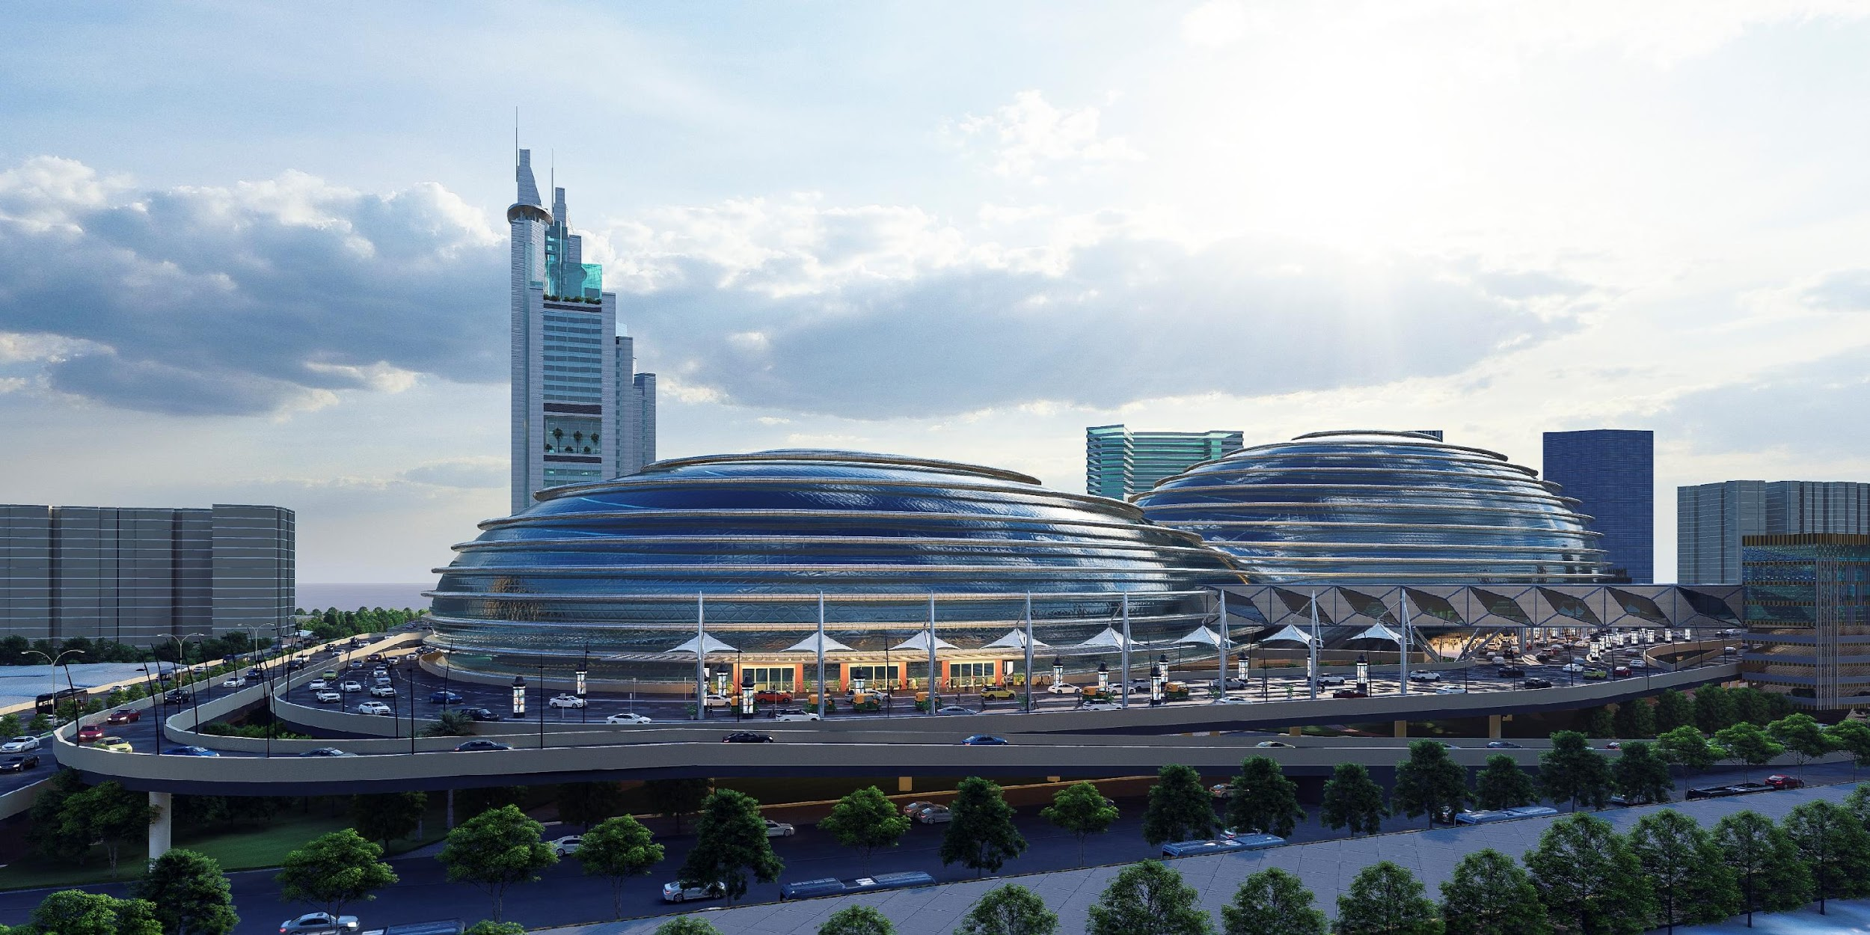
Station as a city center

Slide 13
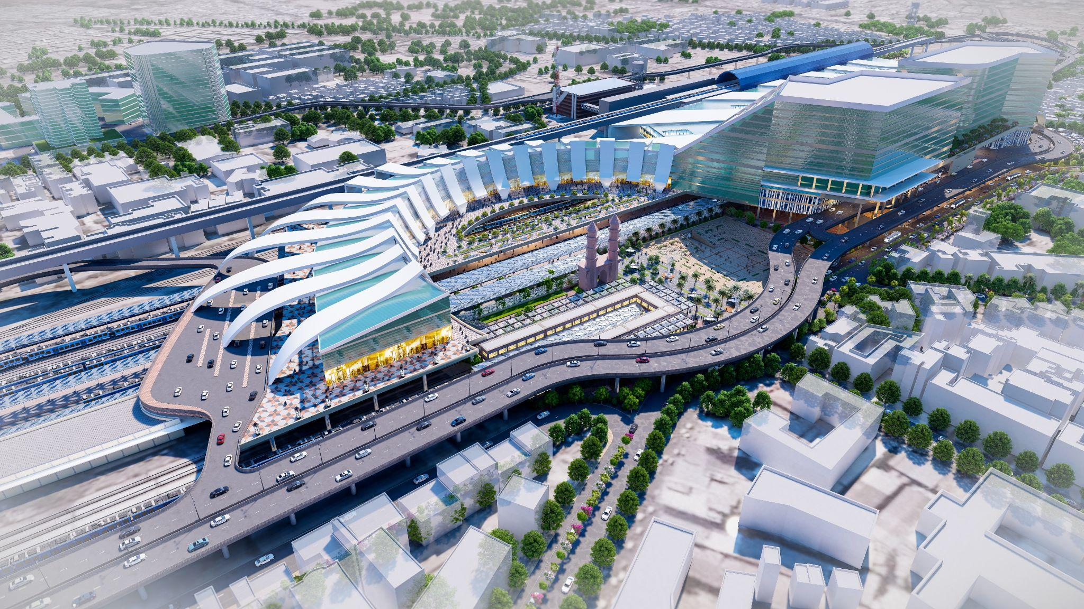
Smooth Approach Roads

Slide 14
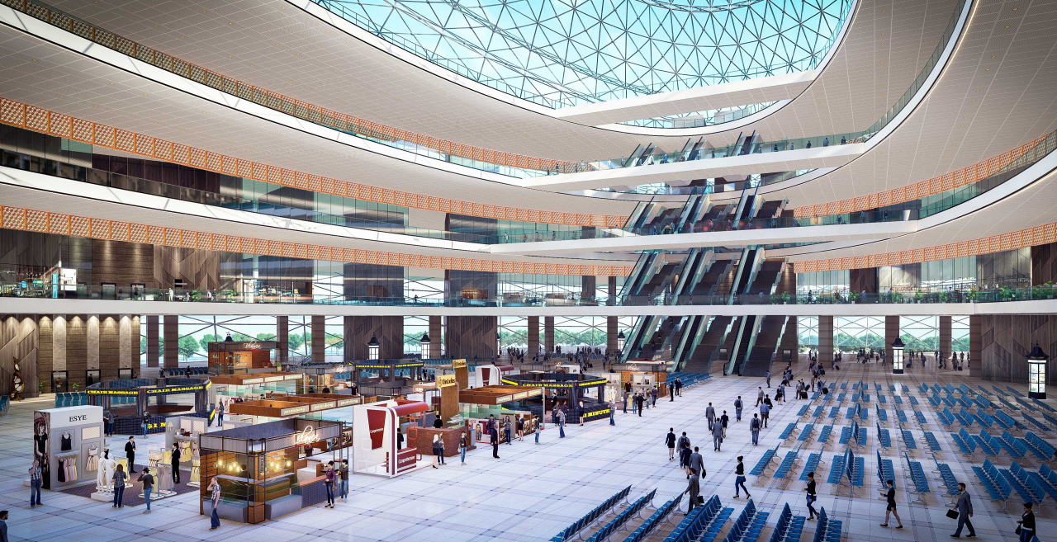
Roof plaza : Creating space

Slide 15
Thank You

